Slide 1

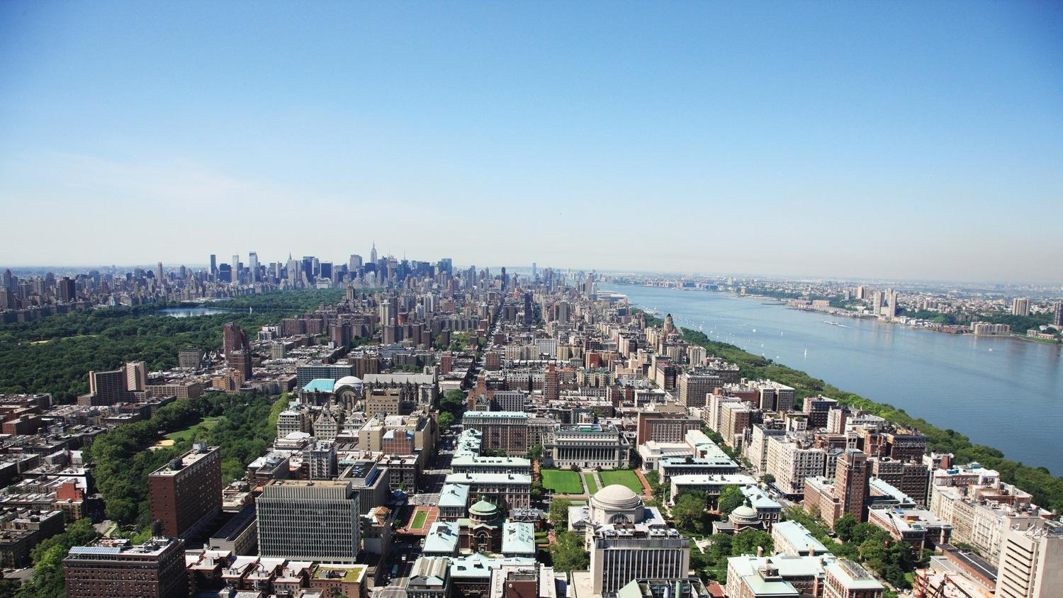
2020 Fall Semester Columbia-FNL Industry Projects
Sarangan Ravichandran, BIDS, FNLCR
Jan 22, 2021

Slide 2
Agenda
2:00 PM: Introduction Dr. Ravi Ravichandran, BIDS, FNL
2:05 PM: Greetings, Dr. Ethan Dmitrovsky, President, FNL
2:10 PM: Student Presentations and Q&A
“Feature Selection For Deep-Learning Models,” Mengyao He
“Repurposing FDA-approved Drugs: An application to COVID-19,” Vincent Fleury
“Predicting Kinase Inhibitors Using Small-Molecule Structure Information,” Jady Tian
2:55 PM: Closing remarks Dr. Eric Stahlberg

Slide 3
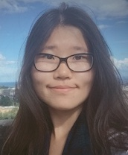
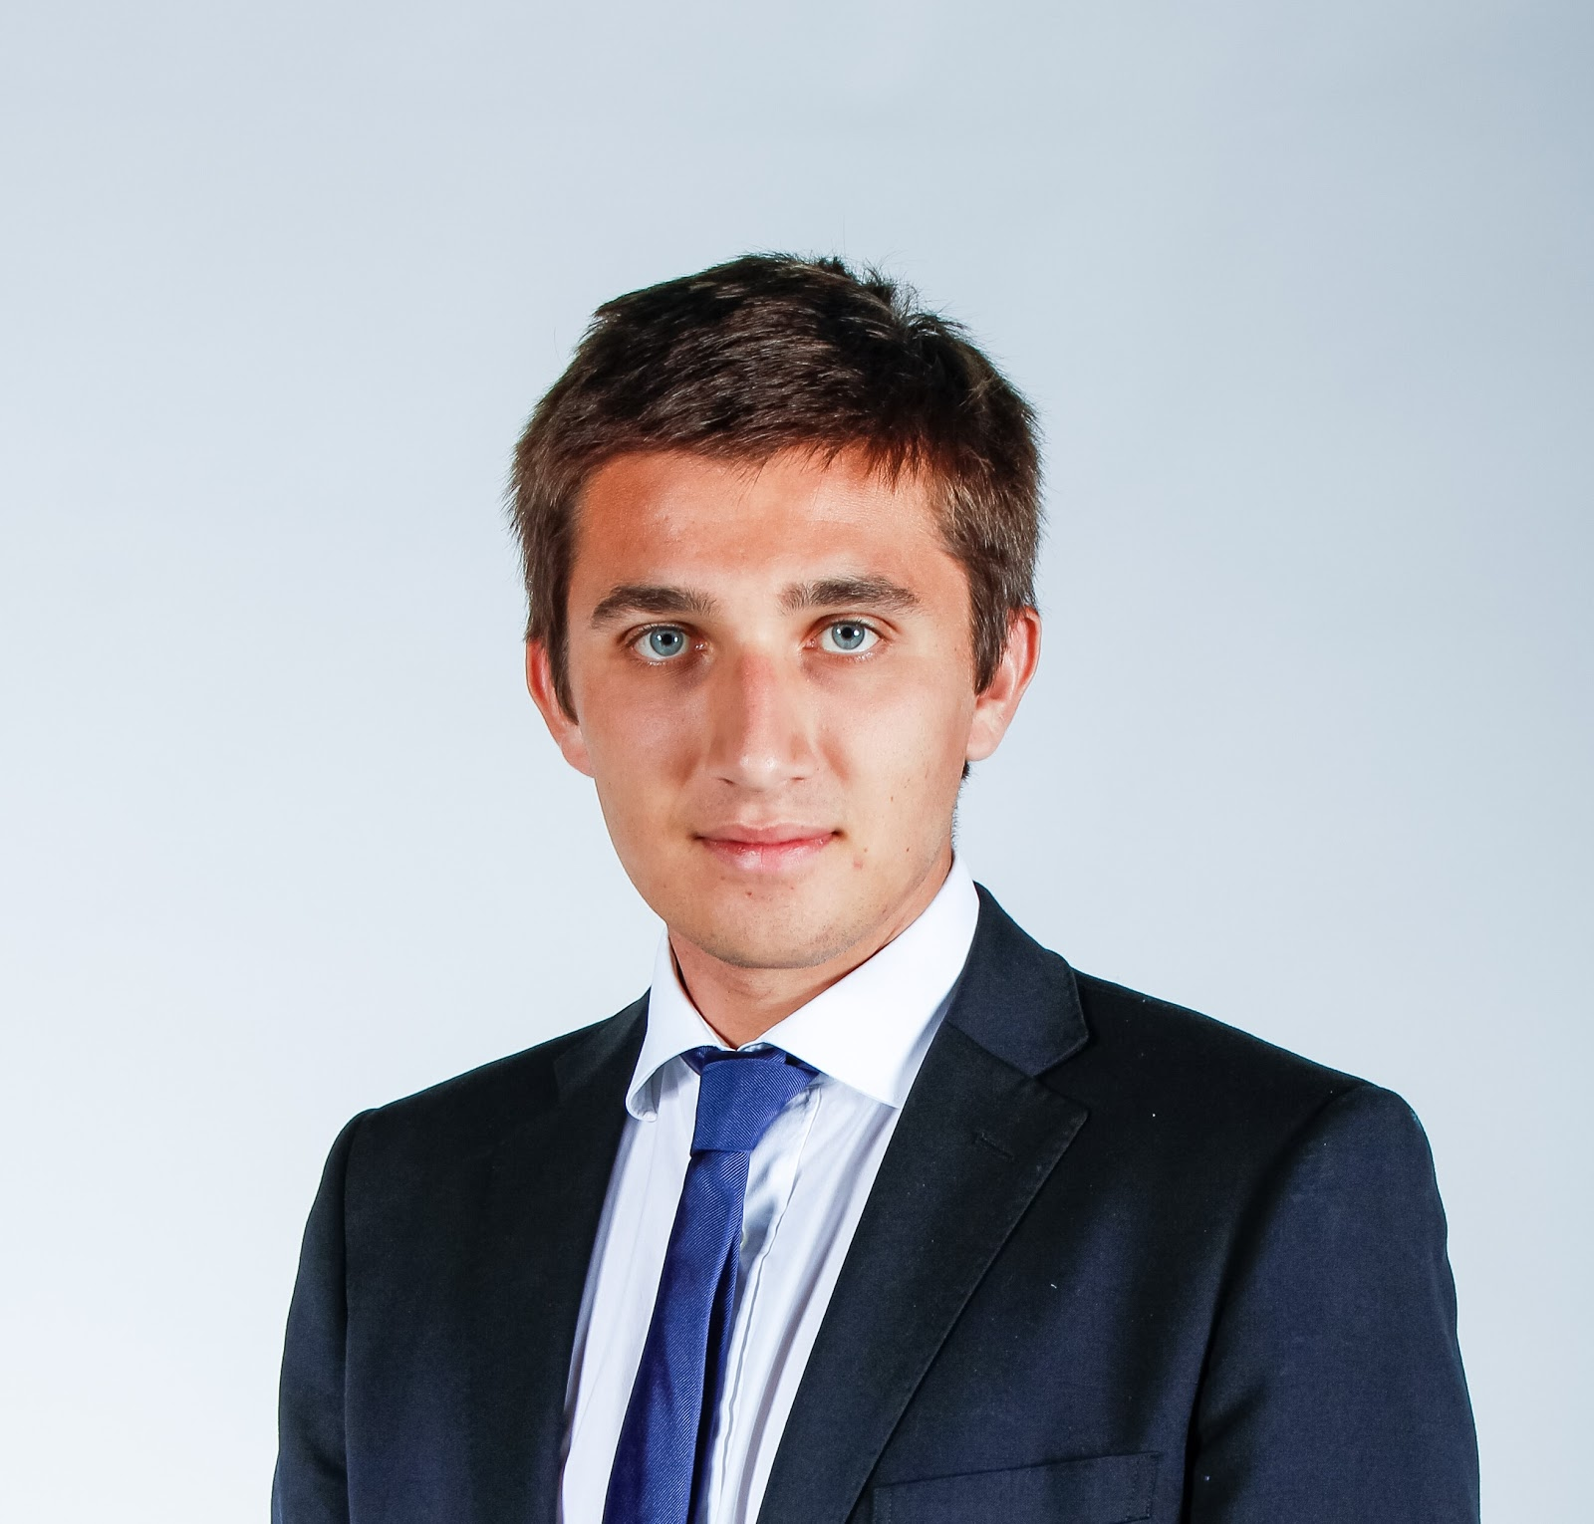
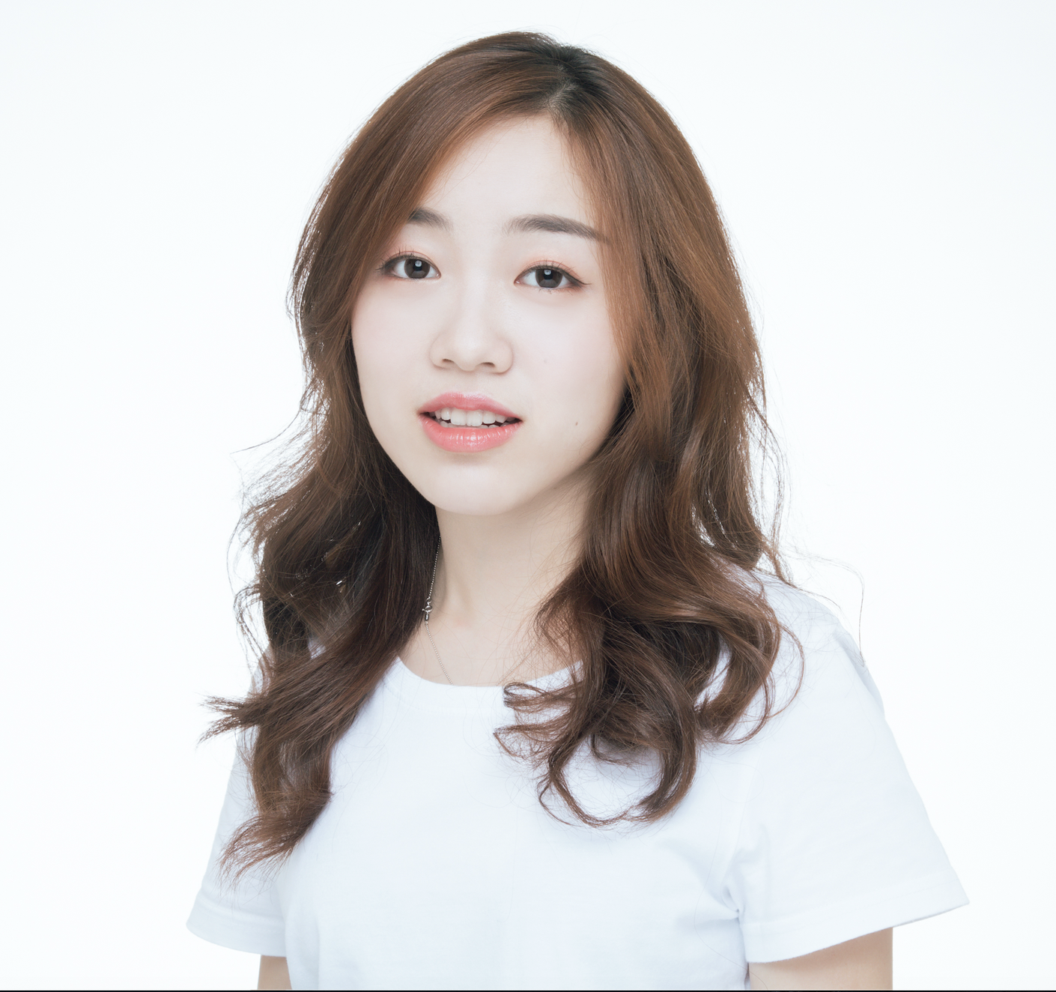
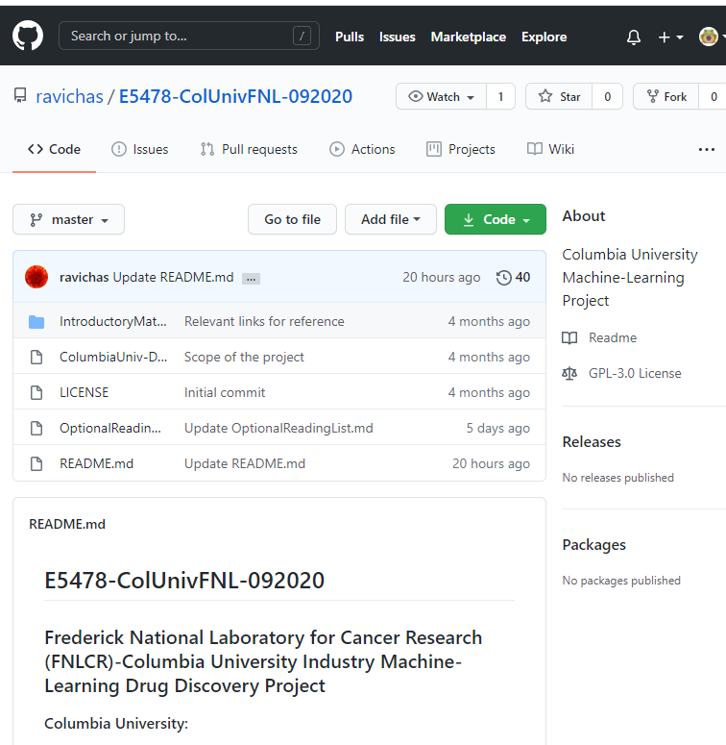
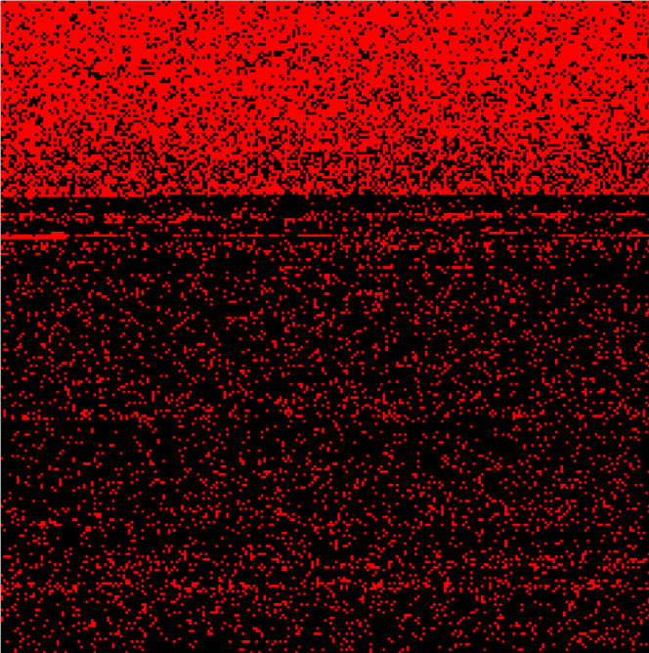
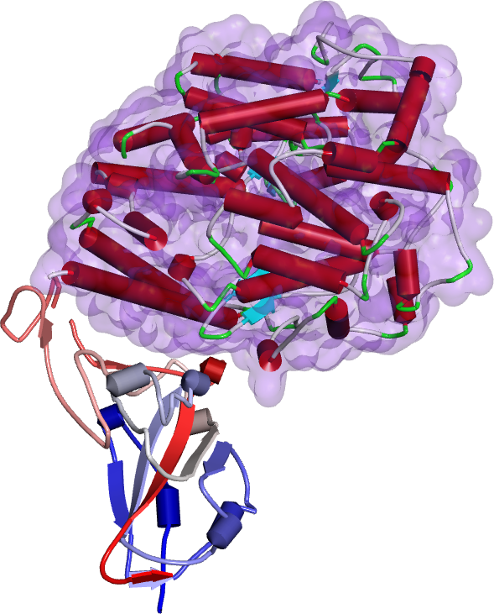
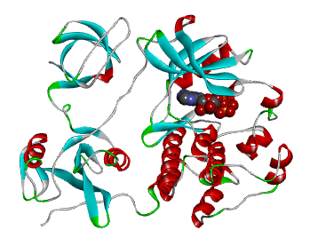
Student Project Overview
Mengyao He
Vincent Fleury
Jady Tian
Kinase inhibition
Genomics/Feature Selection
SARS-Cov-2 Spike RBD
https://github.com/ravichas/E5478-ColUnivFNL-092020

Slide 4
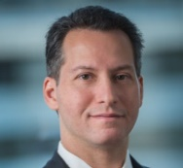
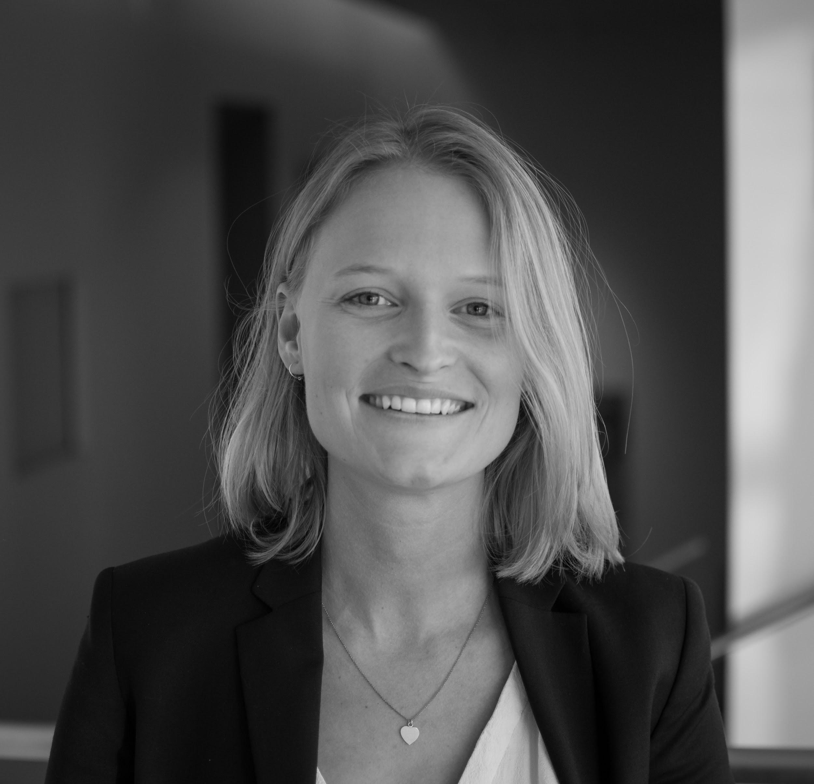
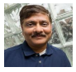
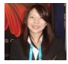
Special Thank You to:
ATOM Team
Dr. Jim Brase, LLNL
Dr. Jonathan Allen, LLNL
Dr. Amanda Paulson, BIDS, FNL
Dr. Da Shi, BIDS, FNL
FNL Leadership
Dr. Ethan Dmitrovsky, FNL
Dr. Maggie Scully, PDO, FNL
Dr. Eric Stahlberg, BIDS, FNL
Michael Robbins
Professor,
Columbia University
Malin Ortenblad TA, Project Manager
Columbia University
Ravichandran Sarangan, PhD
Mentor
Frederick National Lab
Naomi Ohashi
Project Manager
Frederick National Lab

